Slide 1
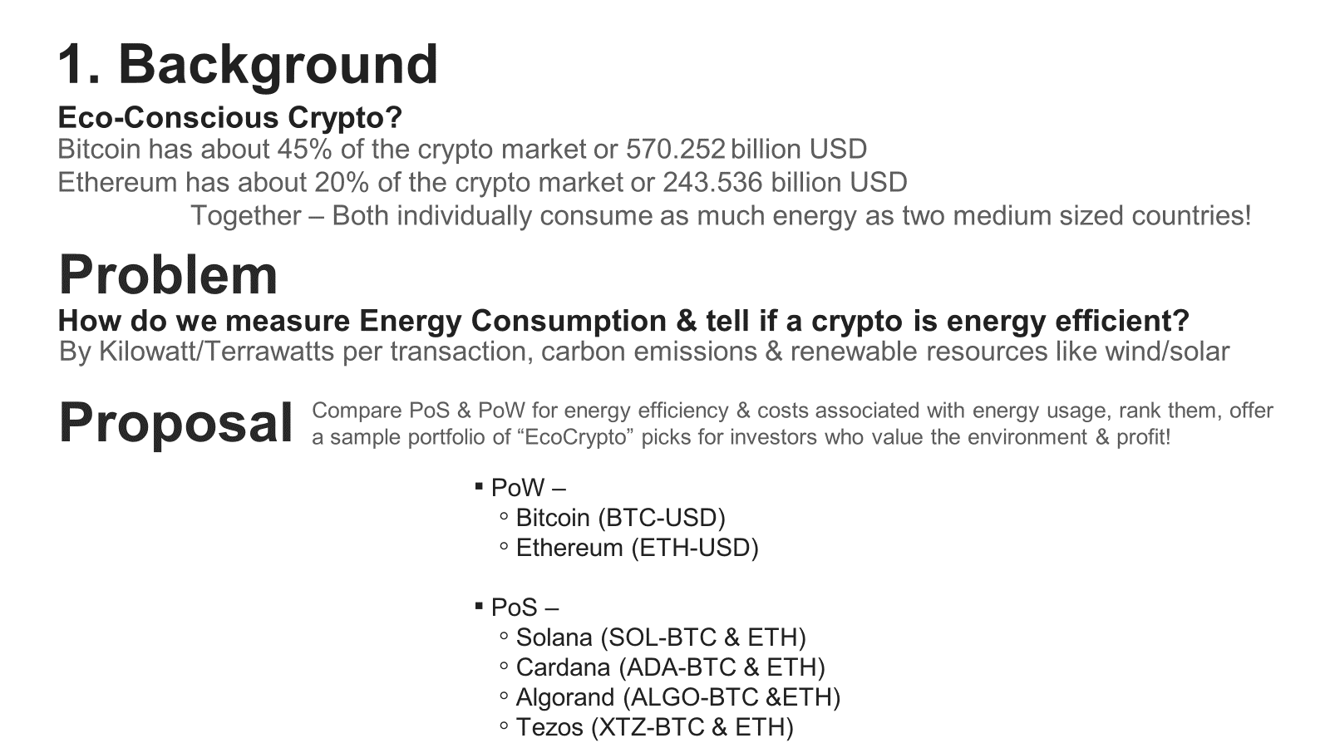

Slide 2
Method
2. Hypotheses
Proof of Stake cryptocurrencies (no matter their expected use) are more environmentally friendly
than non-Proof of Stake cryptocurrencies (specifically comparing Proof of Work cryptocurrencies).
Proof of Work cryptocurrencies outperform Proof of Stake cryptocurrencies in regards to cumulative returns,
however Proof of Stake cryptocurrencies are less volatile and less risky.
Define and distinguish eco-friendly and non eco-friendly blockchain technologies
Define PoW and Pos Portfolios
Fetch and compile Historical Data
Analyze Volatility
Analyze Risk
Monte-Carlo Simulation

Slide 3
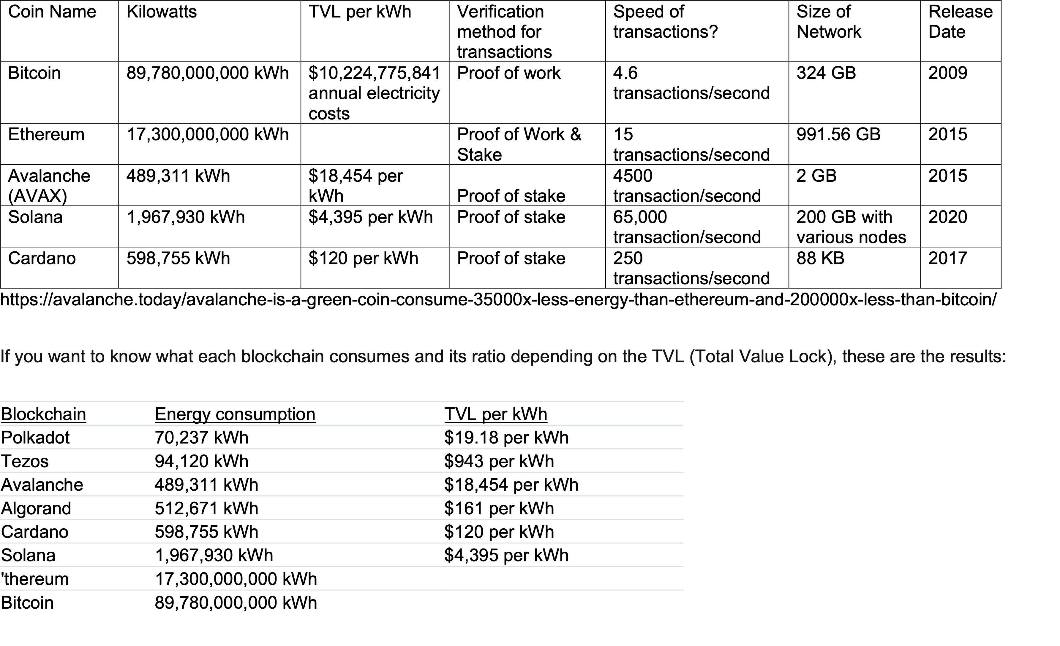
3. Energy & Efficiency Data Compiled

Slide 4
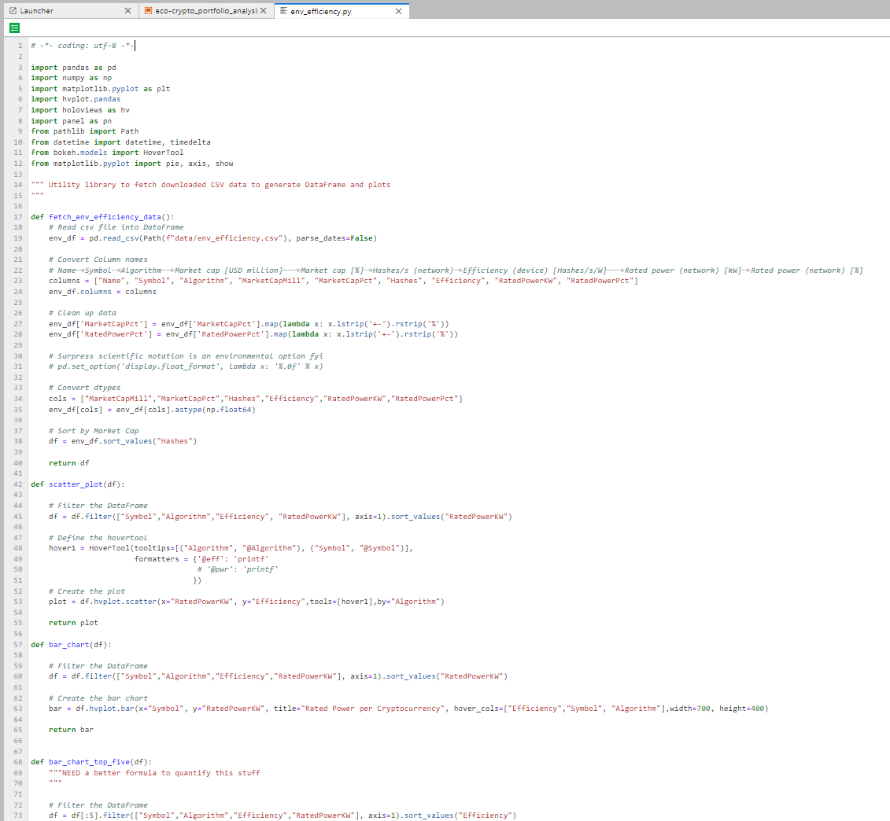
4. Analyzing Efficiency in EcoCryptos

Slide 5
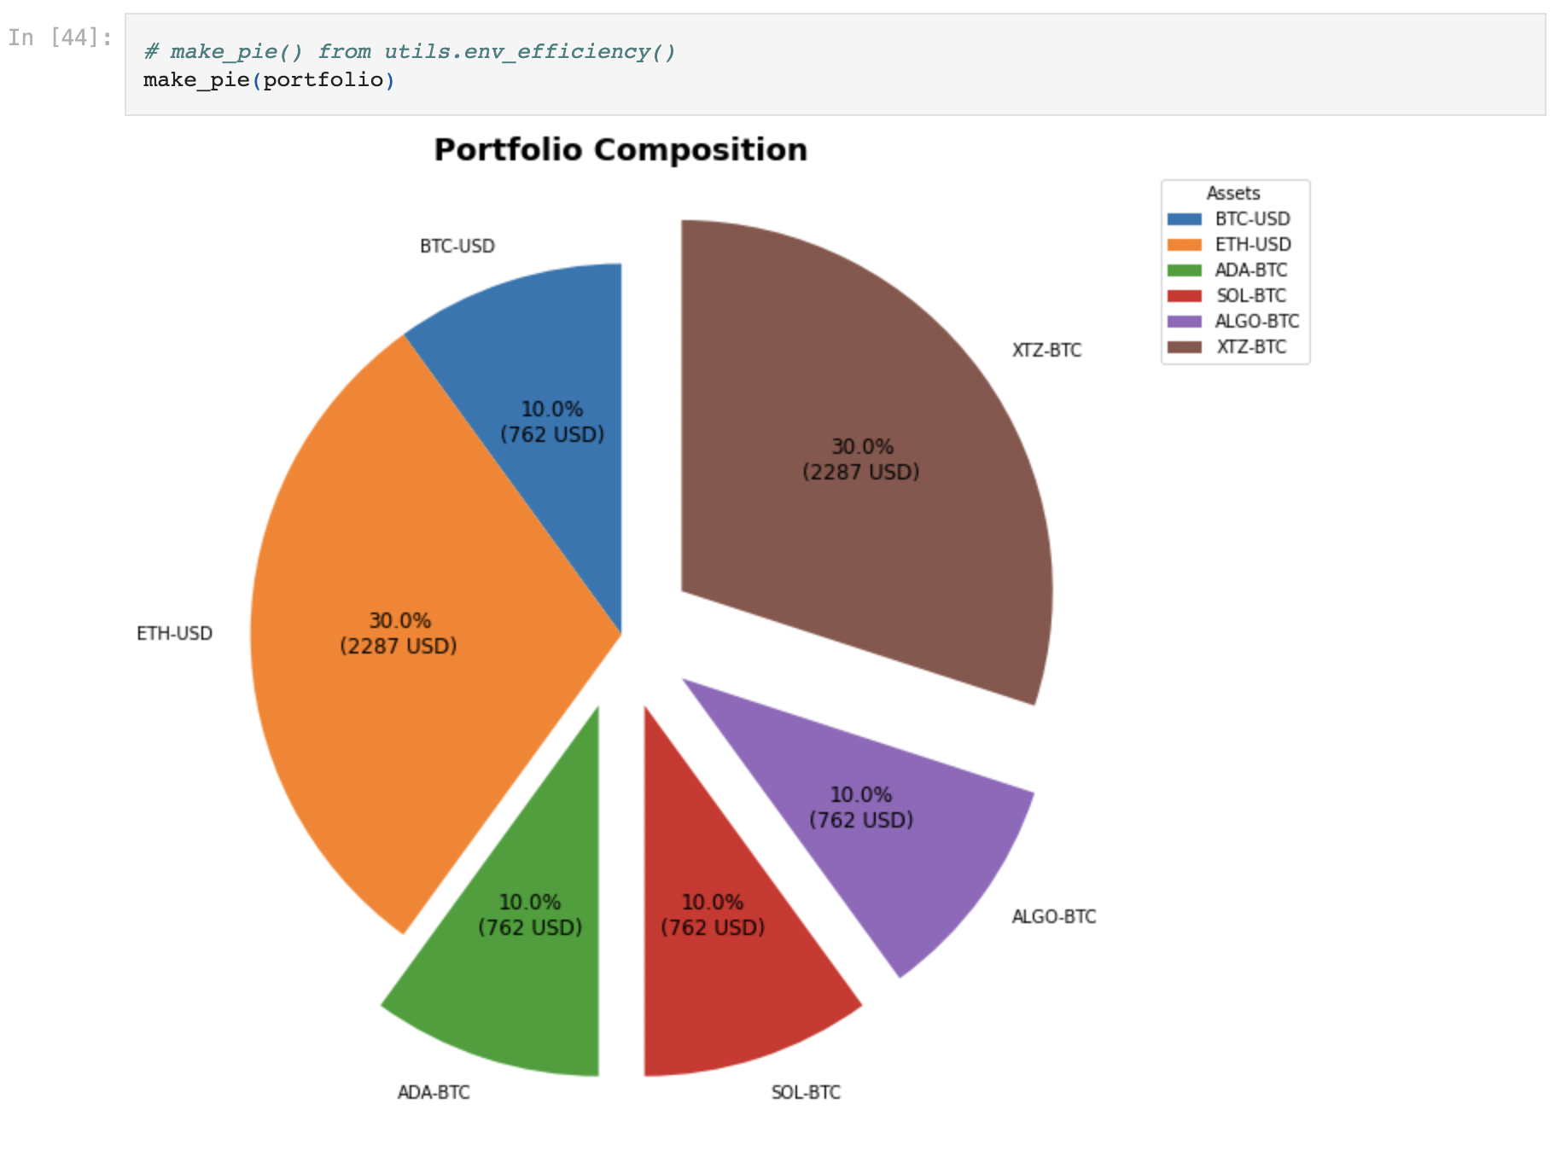
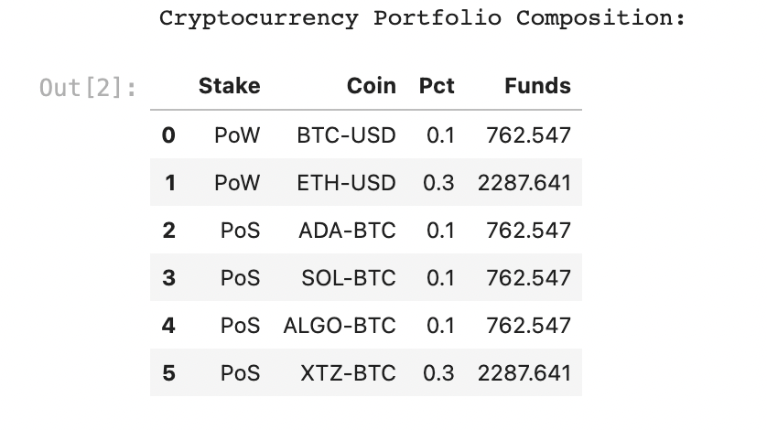
5. Data Collected & Explored via Coinbase

Slide 6
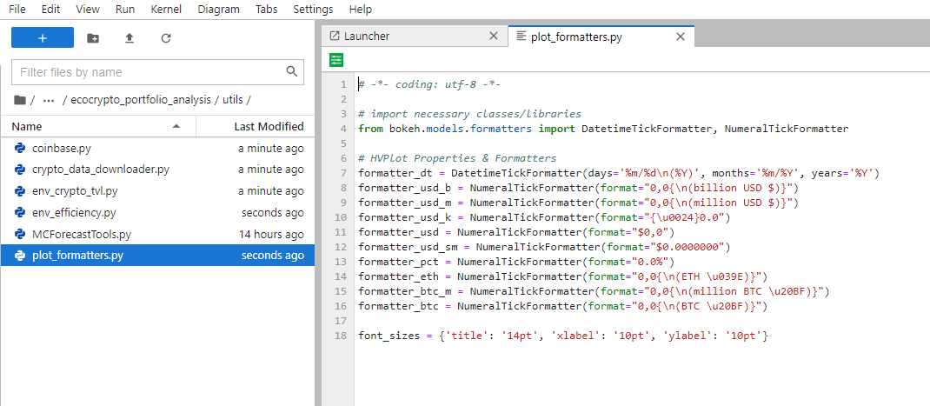
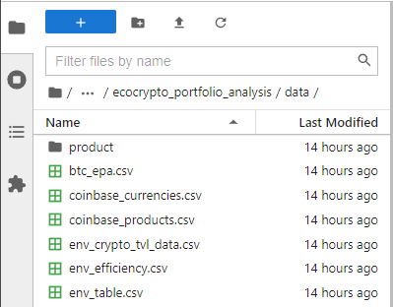
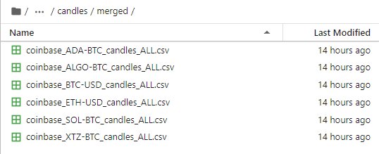
6. Data sets & Data frames utilized

Slide 7
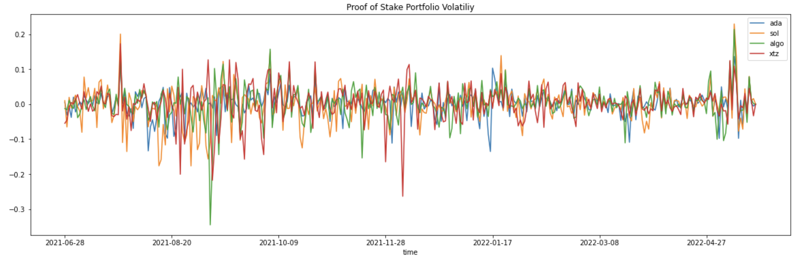
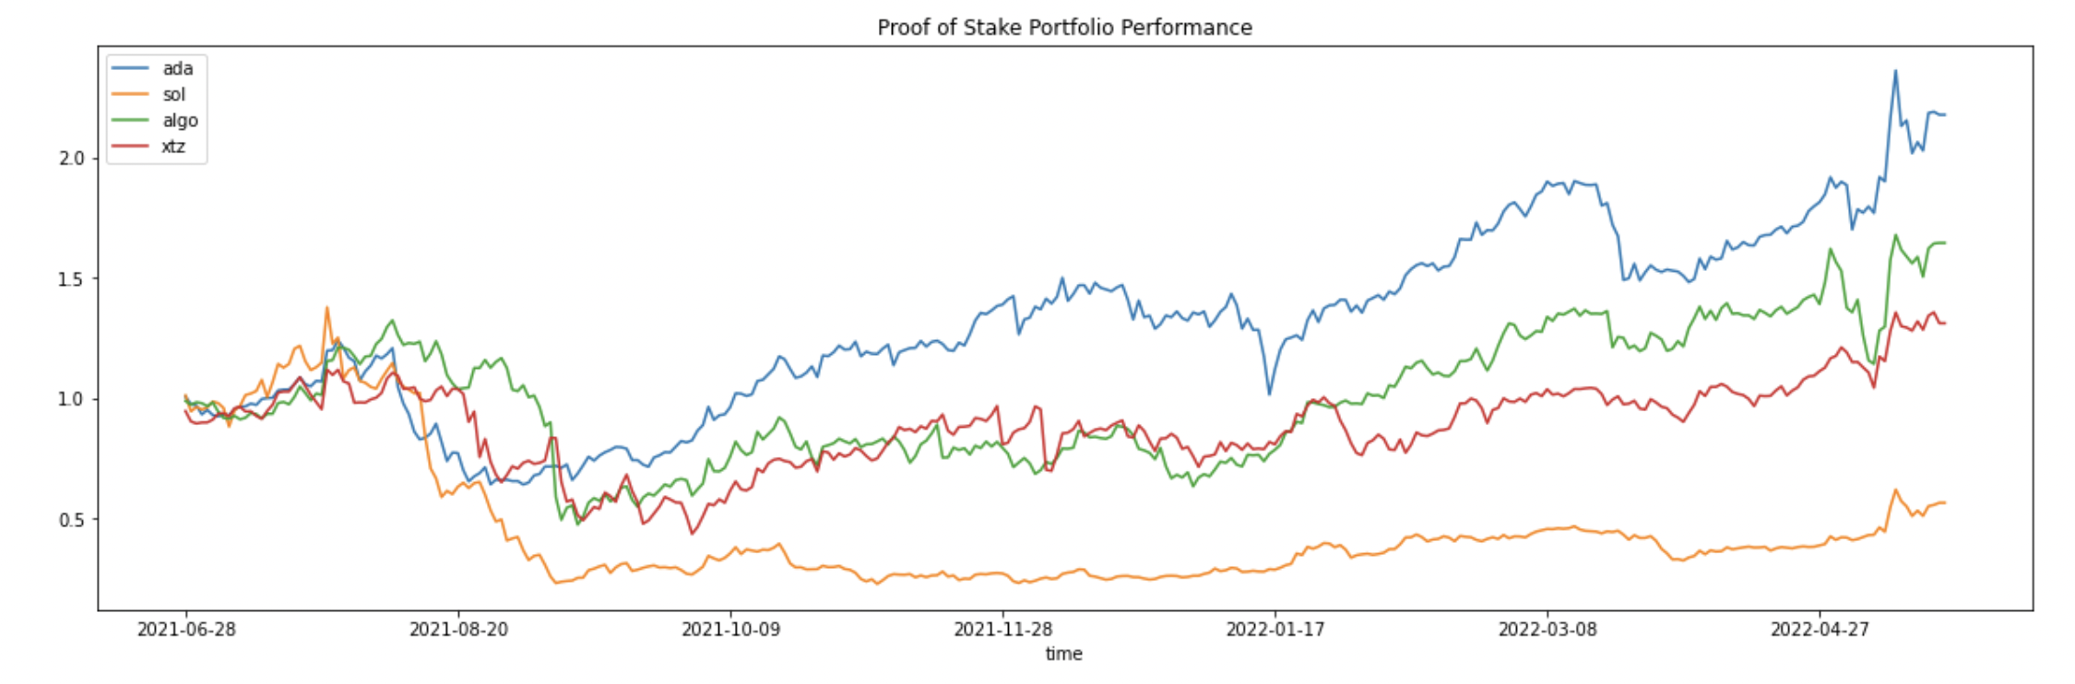
7. Performance & Volatility

Slide 8
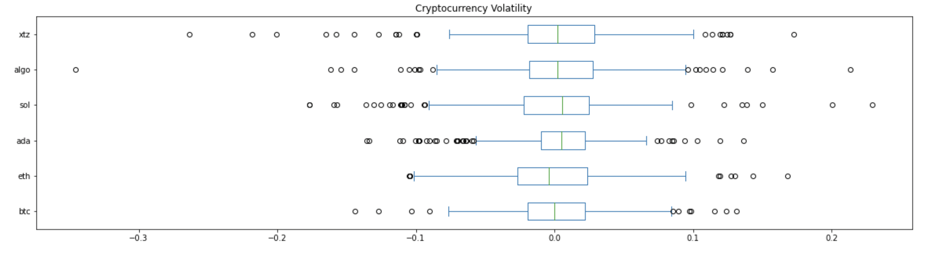
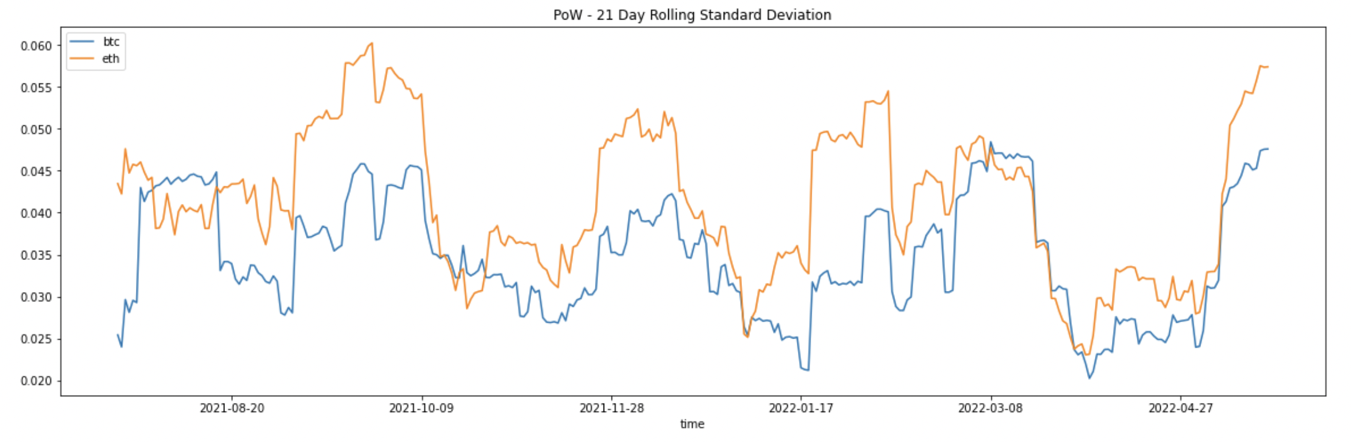
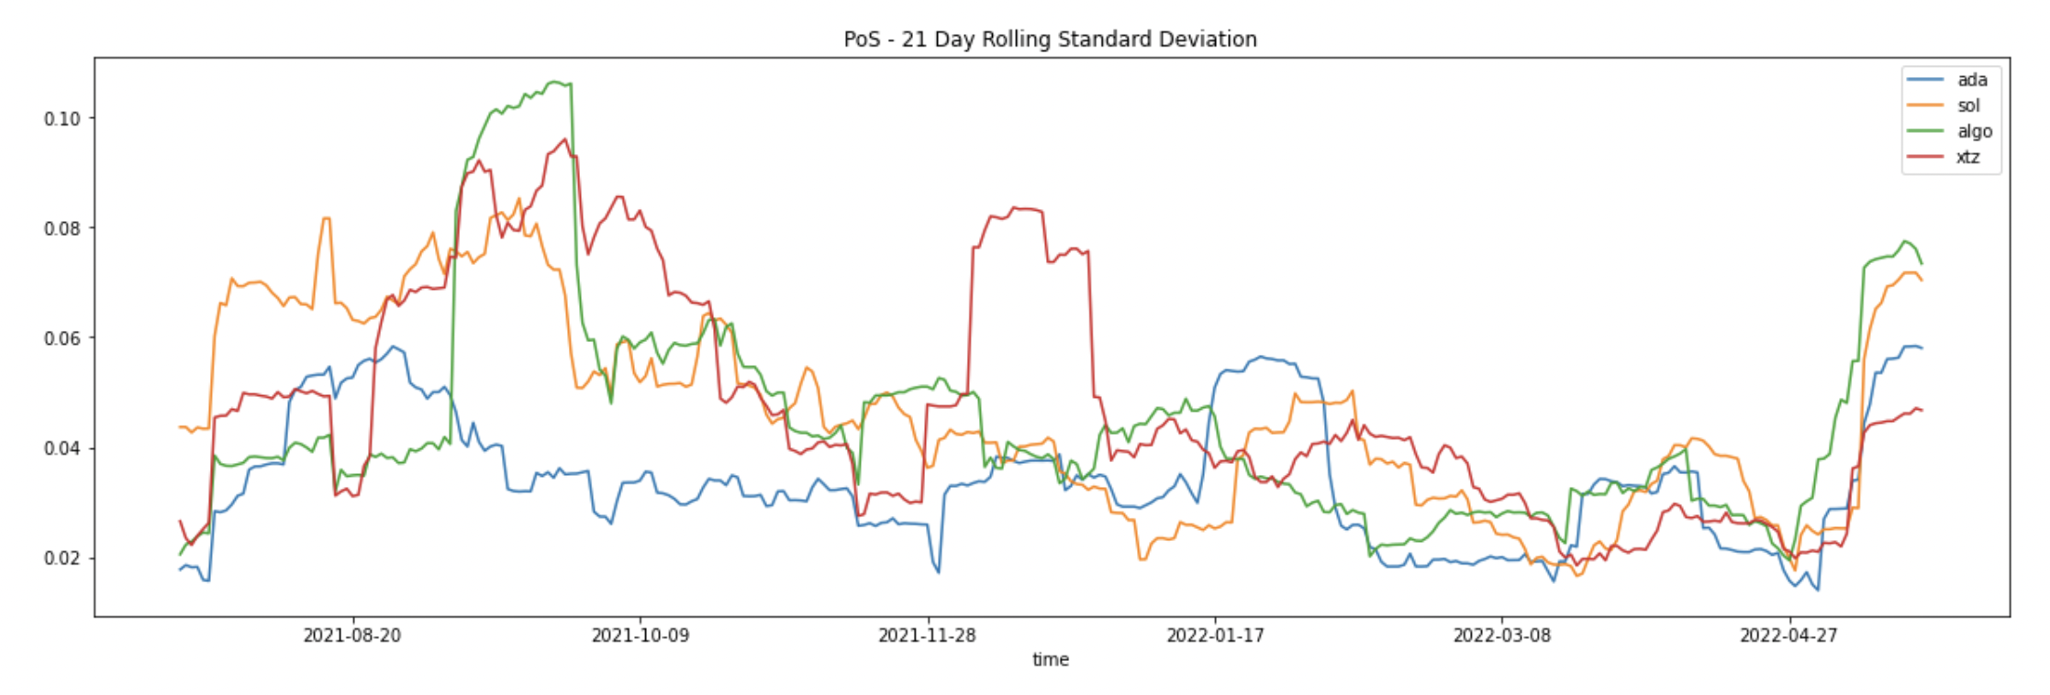
8. Risk Analysis

Slide 9
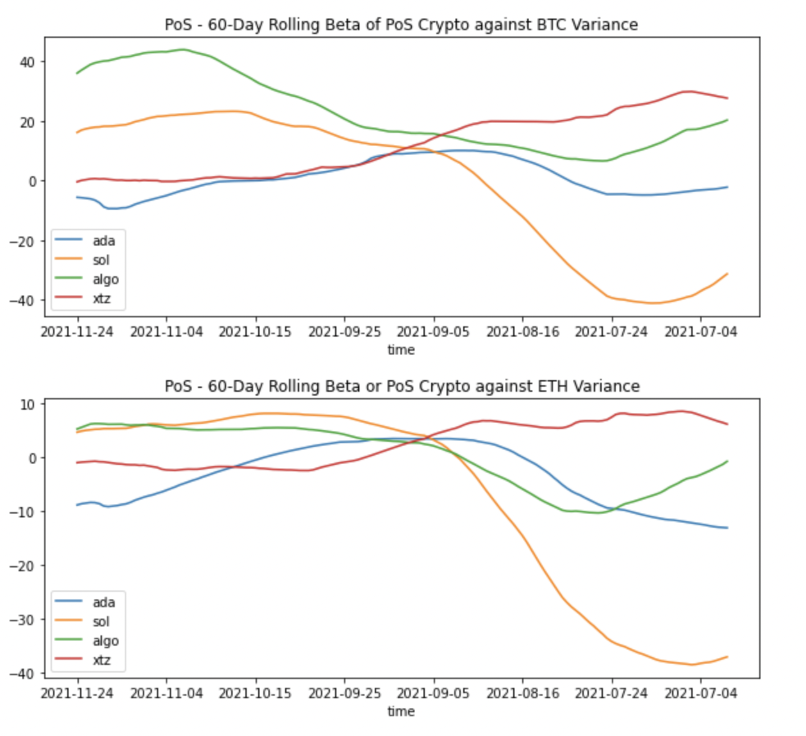
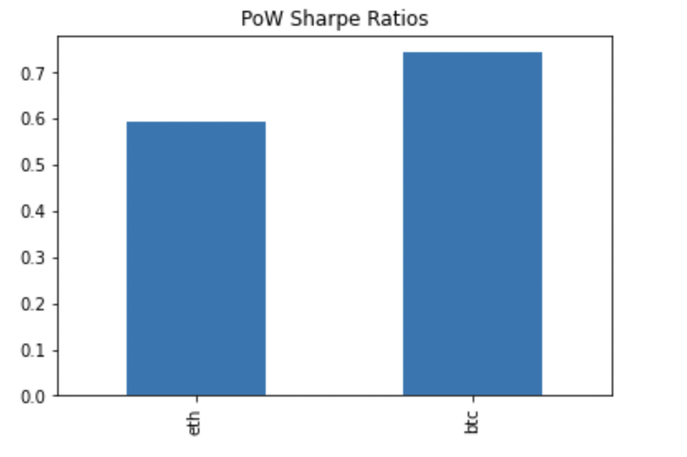
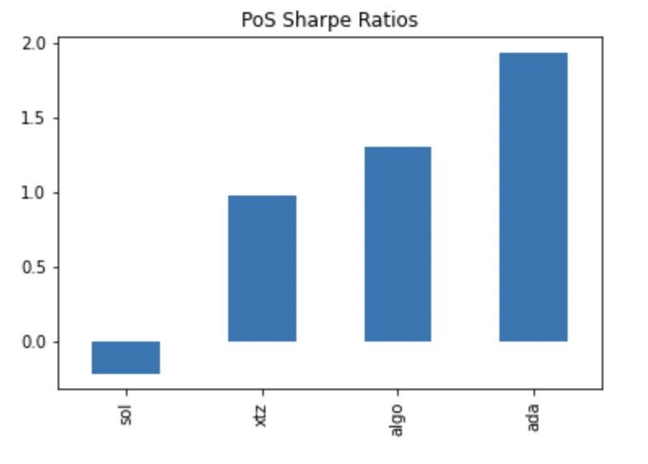
9. Risk Cont.

Slide 10
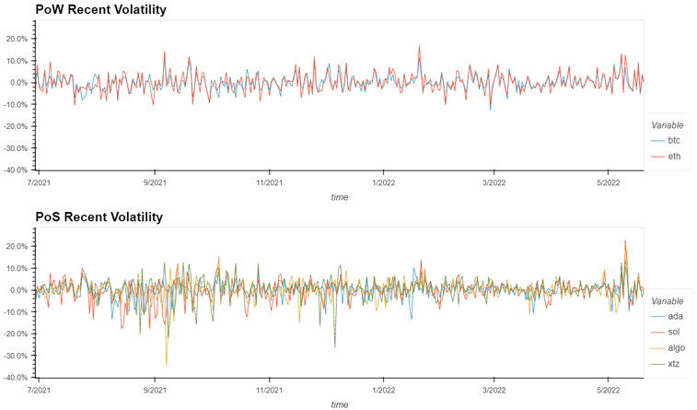
10. Volatility Comparison

Slide 11
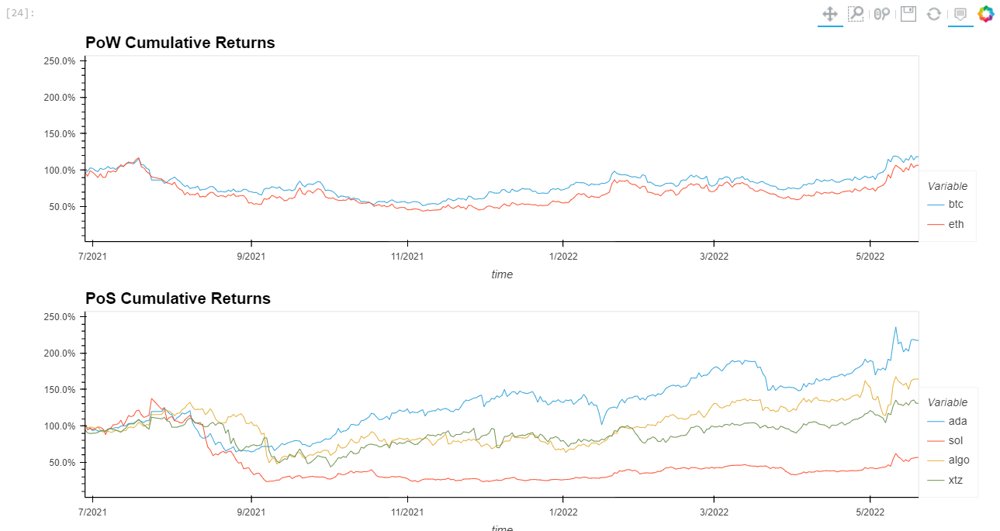
11. Cumulative Returns

Slide 12

12. Monte Carlo Simulation (equal weighted portfolios with 5 year forecast)

Slide 13
16. Conclusions
*The energy mechanism (PoS vs. PoW) is closely related to the total energy consumed of any given cryptocurrency
*Proof of Work consensus mechanisms are MUCH less efficient than Proof of Stake consensus mechanisms
*Energy efficiency of crypto is an important parameter to measure against BTC & ETH who are highly energy inefficient
*Cryptocurrencies are still a fairly volatile commodity regardless of energy consumption, trends in the value of these commodities remains unpredictable

Slide 14
17. Recommendations & Future Research
* Businesses, local, state, and national governments should consider the energy consumption & efficiency of blockchain technologies, as well as longterm environmental impact/sustainability. EXAMPLE – Miami local gov’t use!
*More focus on renewable energy sources for blockchain solutions
*Software Engineers should explore and develop alternative types of consensus mechanisms & verification protocols to avoid excessive energy consumption as blockchain becomes more popular
*Purchase eco-friendly crypto to become a part of the solution!

